Slide 1
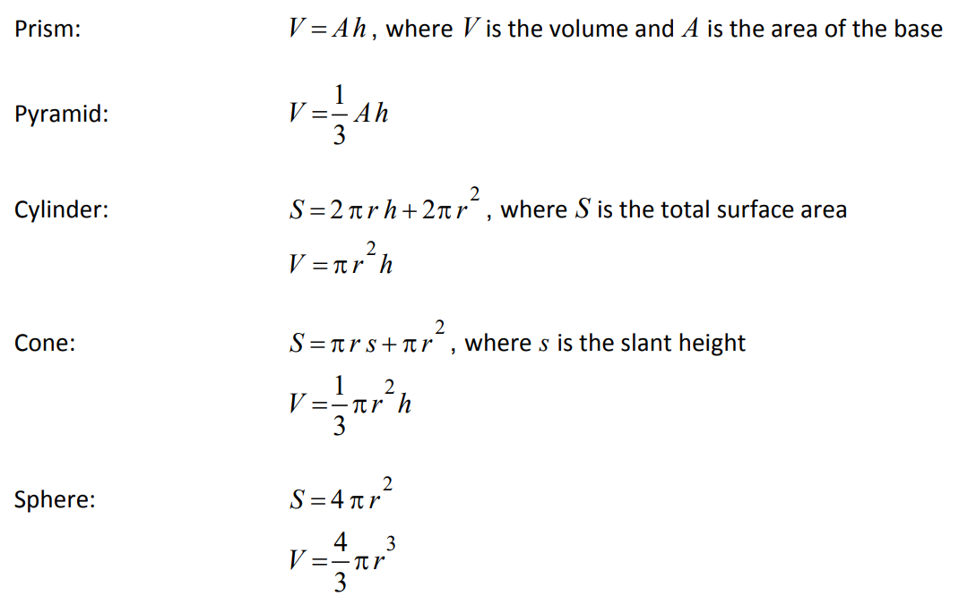
Y11 Apps Chapter 9 Assumed Knowledge
As mentioned at the beginning of Ch 8 there is some assumed knowledge for Measurement. In addition to this, the following Volume and Surface Area formulas are given to you:
The Surface Area for Prisms and Pyramids is not given and will need to be calculated by calculating the area of each side.

Slide 2
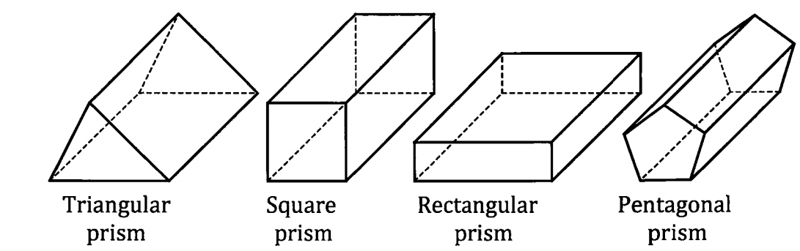
Y11 Apps Chapter 9 VOCABULARY
A prism is a three dimensional shape with all of its faces polygons and with the same shape cross section all along its length.
They are named according to their uniform cross-section and all faces connecting the ‘bases’ or ‘ends’ of the prism will be rectangular.
Notable exceptions to this are cubes, which are special square prisms and a Cylinder which is thought of as a circular prism, but does not technically have polygon faces.

Slide 3
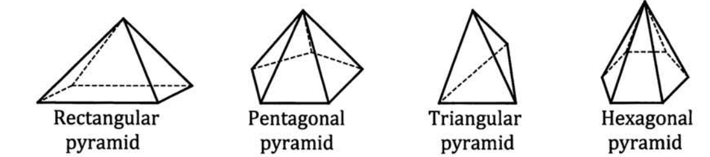
Y11 Apps Chapter 9 VOCABULARY
A pyramid is a three dimensional shape that has a polygon as its base and all the sides meeting at a point, sometimes referred to as the apex.
They are named according to their base shape and all faces connecting the base to the apex will be triangles.
Again a notable exception to this is a Cone which is thought of as a circular based pyramid, but does not have a polygon as the base.

Slide 4
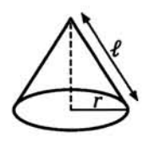
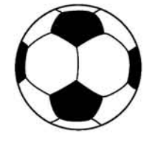


Y11 Apps Chapter 9 Skill Development
As they are Special three dimensional shapes we tend to just use the formula developed for Cones and Spheres.
For a solid cone with base ‘r’ and slant height ‘l’ we use the following:
A Sphere is a ‘ball’ and uses the formula below, ‘r’ being the radius of the ball/sphere:
$$Curved Surface=πrl$$
$$Total Surface Area=4πr^{2}$$
$$Total Surface Area=πrl+πr^{2}$$
Note that your formula sheet uses ‘s’ instead of ‘l’ but both refer to the slant height.

Slide 5
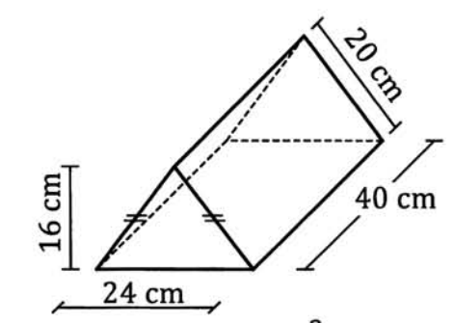
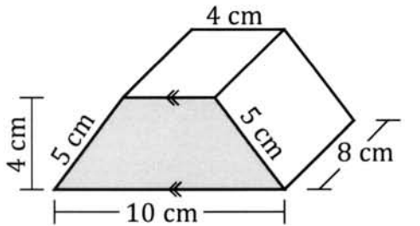
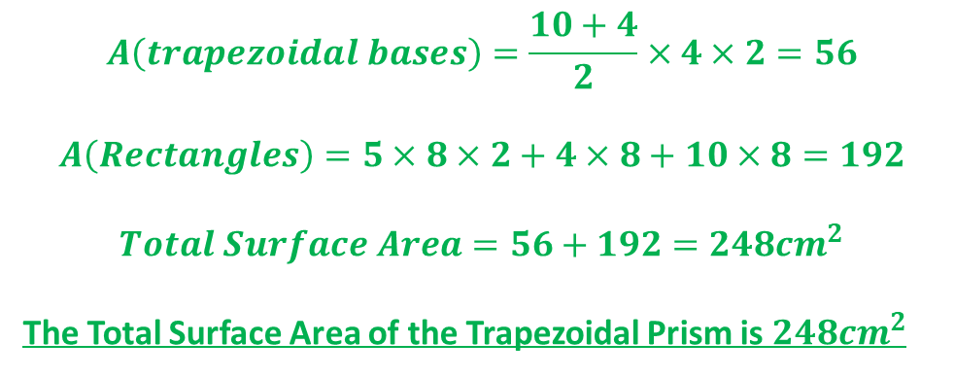
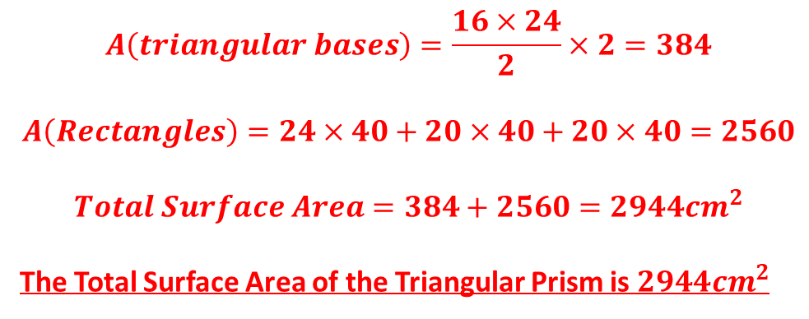
Y11 Apps Chapter 9 Example 1
Find the surface area of each of the following solid bodies:
a) Triangular Prism b) Trapezoidal Prism
$$A\left(triangular bases\right)=\frac{16×24}{2}×2=384$$
$$A\left(Rectangles\right)=24×40+20×40+20×40=2560$$
$$Total Surface Area=384+2560=2944{cm}^{2}$$
The Total Surface Area of the Triangular Prism is $2944{cm}^{2}$
$$A\left(trapezoidal bases\right)=\frac{10+4}{2}×4×2=56$$
$$A\left(Rectangles\right)=5×8×2+4×8+10×8=192$$
$$Total Surface Area=56+192=248{cm}^{2}$$
The Total Surface Area of the Trapezoidal Prism is $248{cm}^{2}$

Slide 6
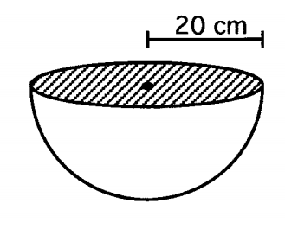
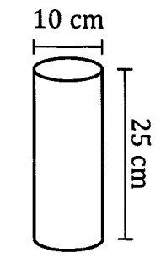
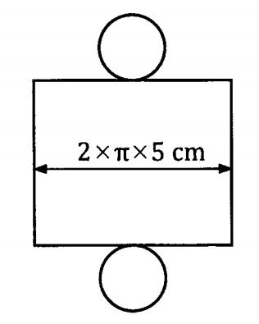
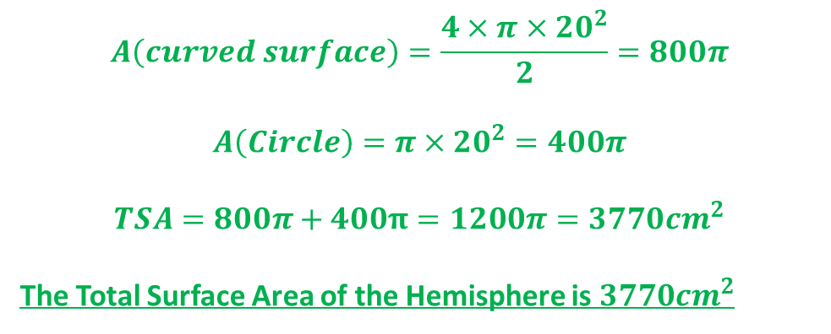
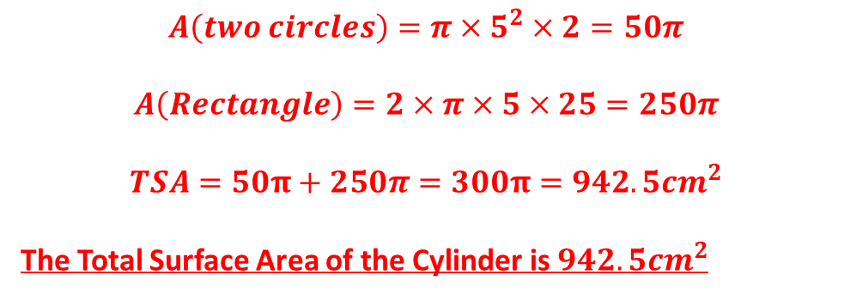
Y11 Apps Chapter 9 Example 2
Now Try Ex 9A
Find the surface area of each of the following solid bodies:
a) Cylinder b) Hemisphere
$$A\left(two circles\right)=π×5^{2}×2=50π$$
$$A\left(Rectangle\right)=2×π×5×25=250π$$
$$TSA=50π+250π=300π=942.5{cm}^{2}$$
The Total Surface Area of the Cylinder is $942.5{cm}^{2}$
$$A\left(curved surface\right)=\frac{4×π×{20}^{2}}{2}=800π$$
$$A\left(Circle\right)=π×{20}^{2}=400π$$
$$TSA=800π+400π=1200π=3770{cm}^{2}$$
The Total Surface Area of the Hemisphere is $3770{cm}^{2}$

Slide 7
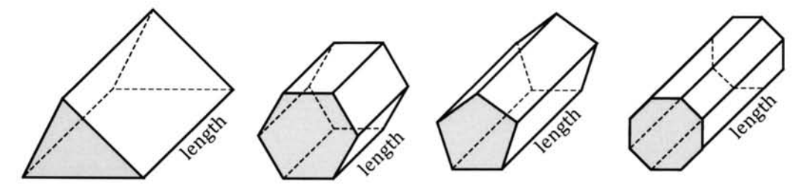
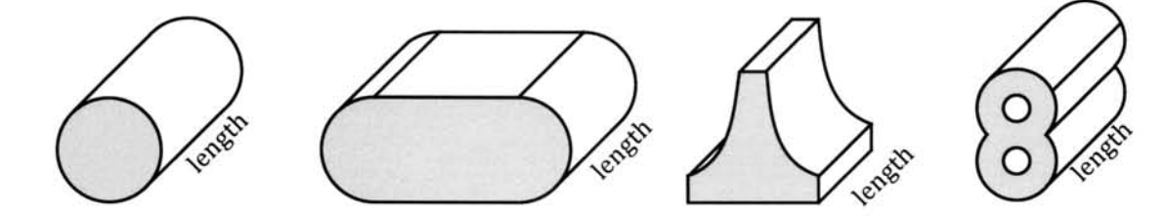
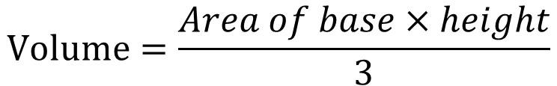

Y11 Apps Chapter 9 Skill Development
Volume is the amount of space taken up by a three dimensional shape.
For any prism, we use the formula below, where the cross-section would be the shaded regions of the shown shapes
$$Volume=Area of uniform cross section ×length/depth$$
The prism volume formula also applies to these shapes with uniform cross section even when the cross section is not a polygon.
For any pyramid, we use the formula below:
$$Volume=\frac{Area of base×height}{3}$$
$$Volume=\frac{4πr^{3}}{3}$$
For a sphere, we use the formula:

Slide 8
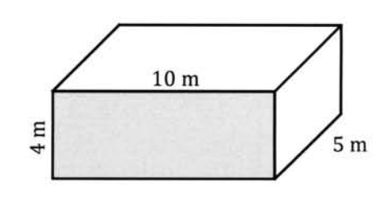
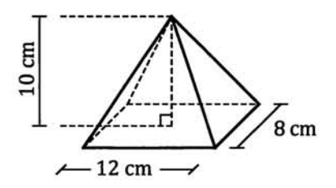
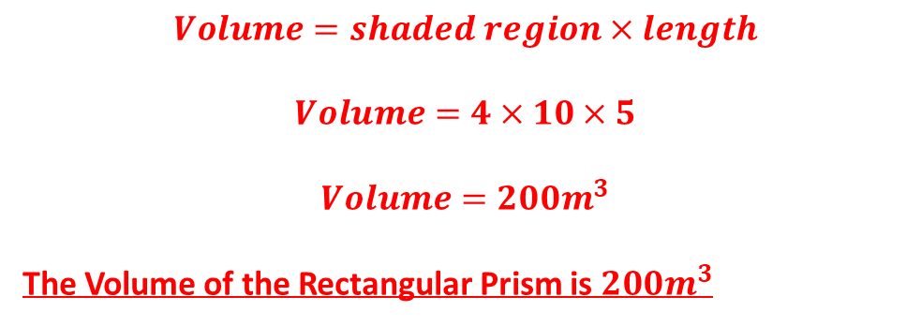
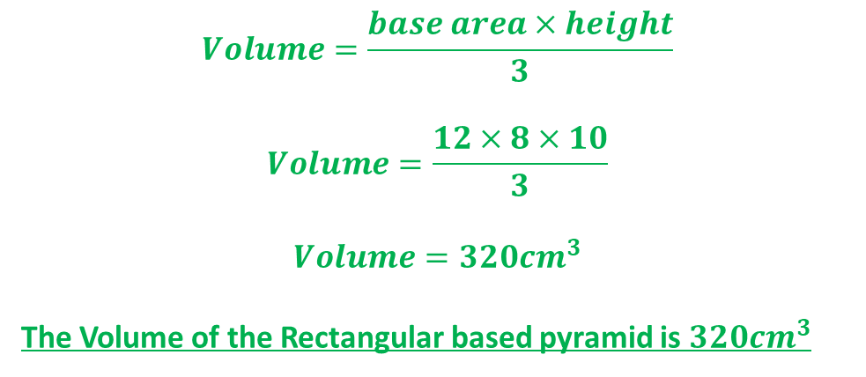
Y11 Apps Chapter 9 Example 3 & 4
Find the volume of the rectangular prism shown:
$$Volume=shaded region×length$$
$$Volume=4×10×5$$
$$Volume=200m^{3}$$
The Volume of the Rectangular Prism is $200m^{3}$
Find the volume of the rectangular based pyramid shown:
$$Volume=\frac{base area×height}{3}$$
$$Volume=\frac{12×8×10}{3}$$
$$Volume=320{cm}^{3}$$
The Volume of the Rectangular based pyramid is $320{cm}^{3}$

Slide 9
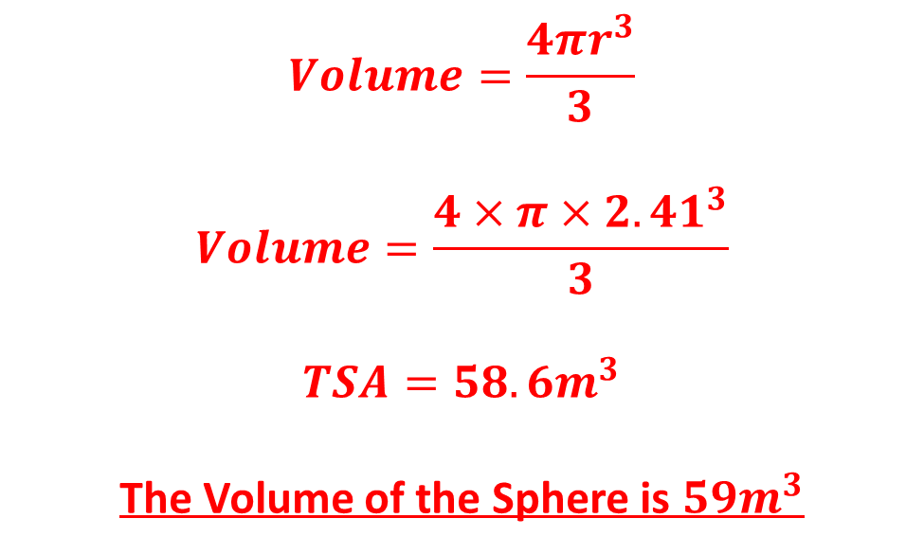
Y11 Apps Chapter 9 Example 5
Find the volume of a sphere of radius 2.41m giving your answer to the nearest cubic metre:
$$Volume=\frac{4πr^{3}}{3}$$
$$Volume=\frac{4×π×{2.41}^{3}}{3}$$
$$TSA=58.6m^{3}$$
The Volume of the Sphere is $59m^{3}$

Slide 10
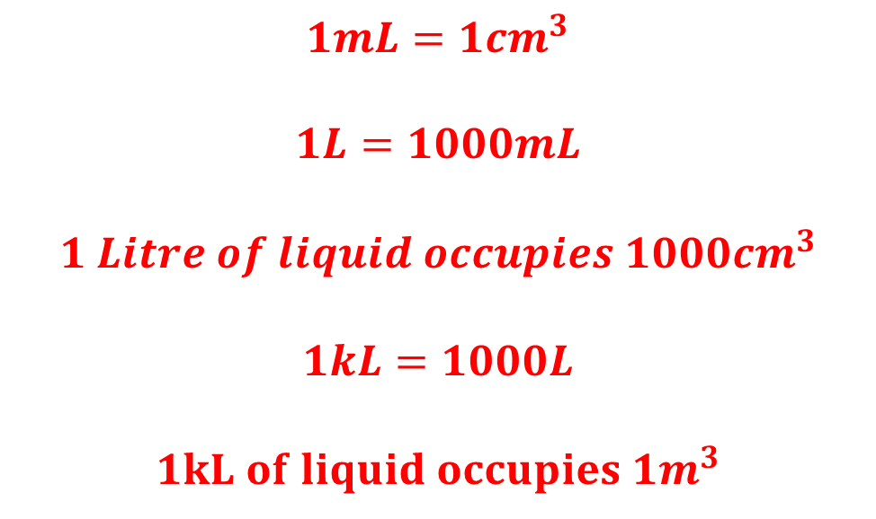
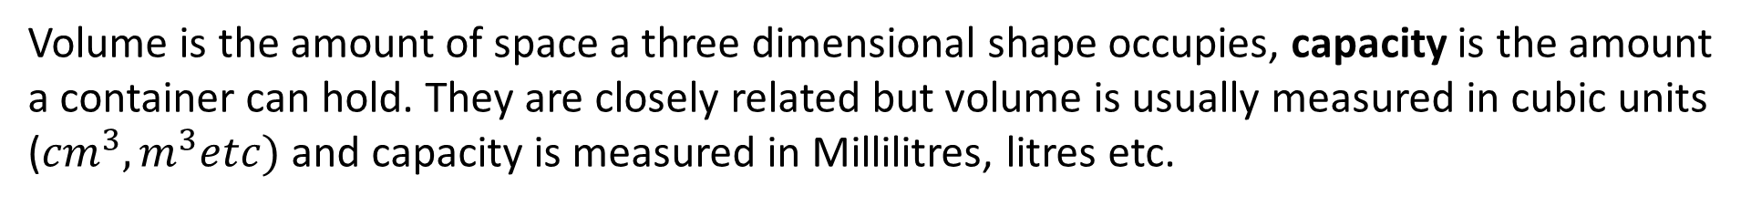
Y11 Apps Chapter 9 Skill Development
Volume is the amount of space a three dimensional shape occupies, capacity is the amount a container can hold. They are closely related but volume is usually measured in cubic units (${cm}^{3},m^{3}etc)$ and capacity is measured in Millilitres, litres etc.
Some common conversions are used to interchange between the measurements
$$1mL=1{cm}^{3}$$
$$1L=1000mL$$
$$1 Litre of liquid occupies 1000{cm}^{3}$$
$$1kL=1000L$$
$$1kL of liquid occupies 1m^{3}$$
Now Try Ex 9B and 9C

Slide 11
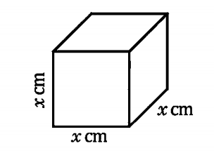
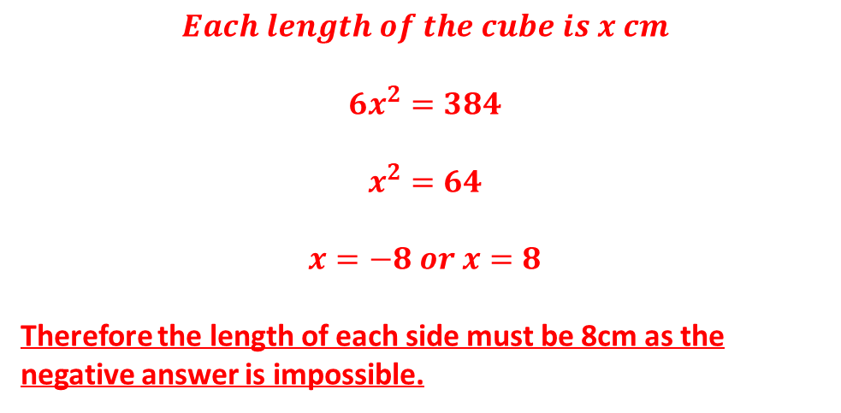
Y11 Apps Chapter 9 Example 6
A solid cube has a total surface area of $384{cm}^{2}$. Determine the length of each edge of the cube:
$$Each length of the cube is x cm$$
$$6x^{2}=384$$
$$x^{2}=64$$
$$x=−8 or x=8$$
Therefore the length of each side must be 8cm as the negative answer is impossible.

Slide 12
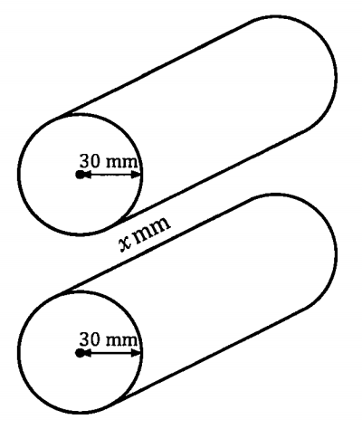
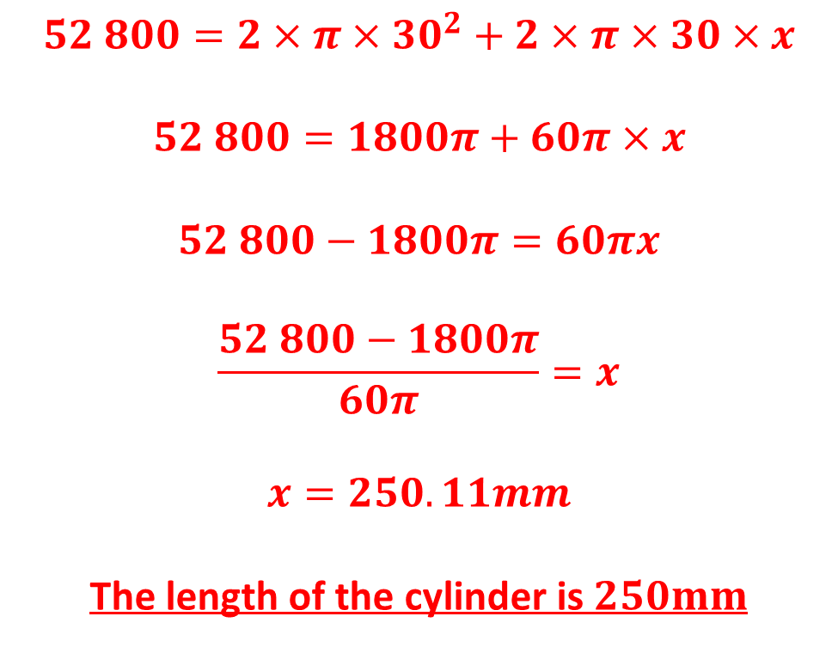
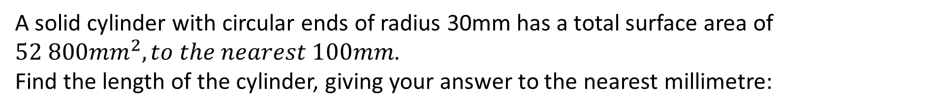
Y11 Apps Chapter 9 Example 7
A solid cylinder with circular ends of radius 30mm has a total surface area of $52 800{mm}^{2}, to the nearest 100mm$.
Find the length of the cylinder, giving your answer to the nearest millimetre:
$$52 800=2×π×{30}^{2}+2×π×30×x$$
$$52 800=1800π+60π×x$$
$$52 800−1800π=60πx$$
$$\frac{52 800−1800π}{60π}=x$$
$$x=250.11mm$$
The length of the cylinder is $250mm$

Slide 13
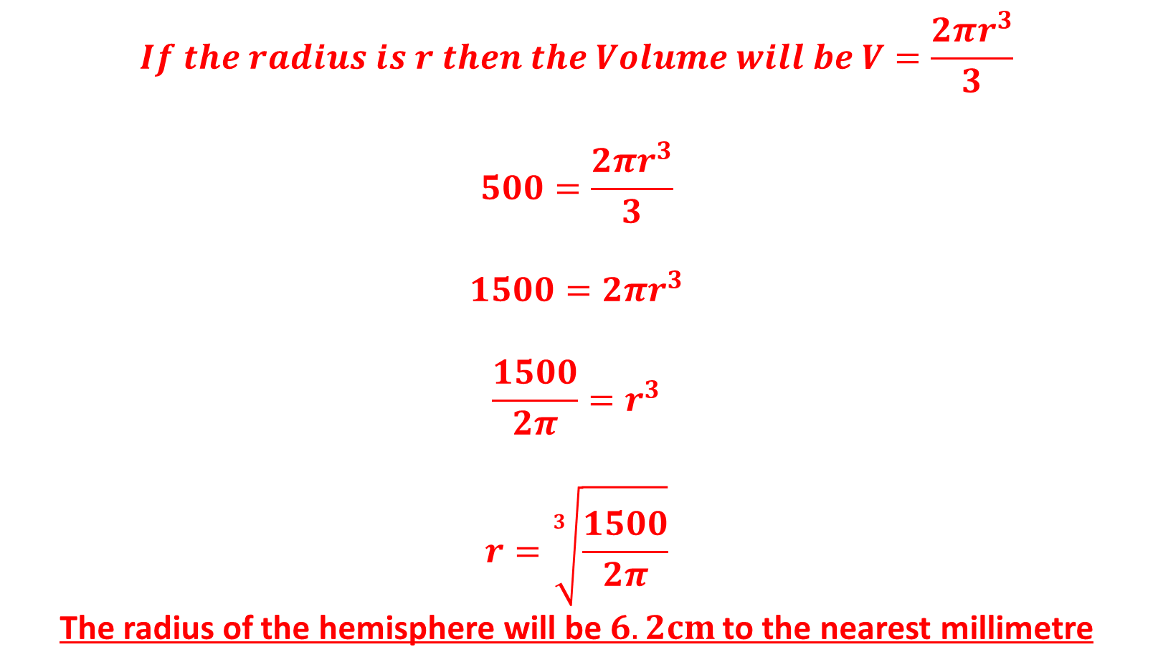
Y11 Apps Chapter 9 Example 8
A hemispherical bowl can hold 0.5 litres of liquid when filled level to the brim. Find the radius of the hemisphere.
$$If the radius is r then the Volume will be V=\frac{2πr^{3}}{3}$$
$$500=\frac{2πr^{3}}{3}$$
$$1500=2πr^{3}$$
$$\frac{1500}{2π}=r^{3}$$
$$r=\sqrt[3]{\frac{1500}{2π}}$$
The radius of the hemisphere will be $6.2cm$ to the nearest millimetre
Now Try Ex 9D

